Slide 1


UChicago Medicine.
Appointment No-Show & Cancellation
By: Georgia Bakopoulos, Alexandra Korol, Katherine Oliynyk, Mitchell McCarvel, Patryk Suszko, and Bryce Robbins

Slide 2
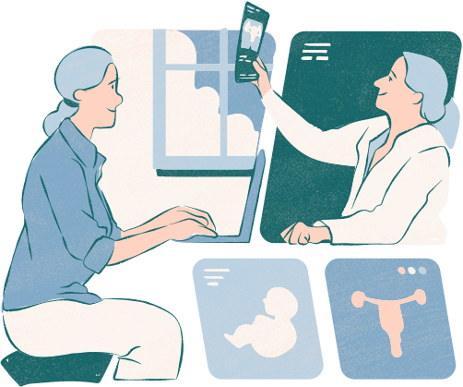
Business Need & Value
The request is to help mitigate the amount of “no show” appointments in the University of Chicago hospital
No shows lead to many issues within the hospital
Creates time issues
Wastes resources (staff, doctors, etc.)
Ultimately creates a mismanaged schedule and could lead to financial troubles
The hospital needs to find a way to help reduce the amount of “no show” appointments to do away with some of the issues presented above
Business Need: Lower the University of Chicago Hospital’s percentage of patients not showing up to scheduled appointments
A no-show leads to:
Wasted resources (staff & doctor’s time, consultation room cleaning resources)
Mismanaged schedule and financial discrepancies
Business Value:
Improve physician productivity
Efficient use of hospital resources
Increase ambulatory (outpatient service) revenue
Notes:
Mitchell

Slide 3
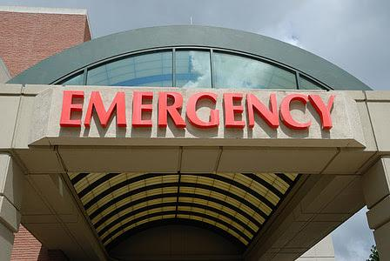
Background Information
Current average no show rate is 20%, meaning 1 in 5 appointments are no-shows.
Groups that are most likely to no-show or cancel:
Young adults
Pediatric patients: children rely on their parents to take them to appointments
Higher rate of no shows in returning patients.
Notes:
Mitchell

Slide 4
Overview Of Our Proposal
Text/call reminders will be followed up by an additional message after 24 hours if no response is given, where the appointment will simply be canceled if no response is received 24 hours prior to the scheduled appointment time.
With this time, employees can see if a waitlisted patient would like to fill the open time slot.
Upon cancellation, rescheduling options will be sent out to patient.
Patients will be entered into a raffle to award and incentivize good attendance.
A survey will be sent out to patients to collect data on their reasons for a no-show, which will also provide resources to combat no-shows.
Recommendation to hire an additional staff member: more details in later slides
Notes:
Mitchell

Slide 5
Use Case 1: Current Appointment Reminders and Cancellation
Current Process
1.System Check: Automated check identifies all appointments within the next 7 days.
2.Retrieve Contact Information: System or staff retrieves patient’s contact info.
3.Send Reminder Notification: A reminder is sent via email, SMS, or automated phone call. EPIC’s patient data can be used to set the frequency of reminders.
4.Confirmation: The reminders sent via MyChart or text often include options to confirm, reschedule, or cancel the appointment with just a few clicks.
4.a. If patient chooses to cancel, they are asked to provide a reason for cancellation, however, this step is voluntary.
5. Second Reminder (No Response): If no response, follow-up reminders are automatically sent, usually a day or two before the appointment date. Appointment is not cancelled, even if no response is given
ID: 0001
Priority: High - Addressing No-Shows
Actors: Patient, Hospital Staff
Description: This use case outlines procedures for contacting patients before scheduled appointments to confirm attendance, as well as the MyChart cancellation process
Trigger: Upcoming appointment (approaching within 7 days).
Type: Temporal
Preconditions:
Patient appointment is in the hospital’s scheduling system.
Contact details (email, phone number) for the patient are available in the system.
Notes:
Georgia Bakopoulos
This use case addresses outreach to patients ahead of scheduled appointments.
It’s classified as high-priority due to the negative impact of no-shows on hospital efficiency.
The actors are of course the Patient and the Hospital Staff/System.
This use case outlines procedures for contacting patients before scheduled appointments to confirm attendance, as well as the MyChart cancellation process
The process’s trigger is temporal because an appointment scheduled within the next seven days will automatically undergo this process as long as it meets the preconditions.
These include the patient appointment being in the hospital’s scheduling system, as well as the patient’s contact details.
The normal course is as follows:
System Check:
An automated check identifies all appointments scheduled within the next seven days.
Retrieve Contact Information:
The system or staff retrieves the patient’s contact information from the scheduling system.
Send Reminder Notification:
A reminder is sent to the patient via email, SMS, or automated phone call.
Confirmation OptionsThe reminders sent via MyChart or text often include options to confirm, reschedule, or cancel the appointment with just a few clicks.
4.a. If patient chooses to cancel, they are asked to provide a reason for cancellation, however, this step is voluntary
5. Second Reminder (No Response): If no response, follow-up reminders are automatically sent, usually a day or two before the appointment date. Appointment is not cancelled, even if no response is given

Slide 6
Our Proposal: Appointment Cancellation
Make it mandatory for patients to provide a reason for cancellation.
This will give the hospital feedback in the form of data about why patients are not coming in for appointments.
Can be used to assess potential issues
Simple process:
adds only one extra step to the cancellation process.
Notes:
Georgia.

Slide 7


Text/Call Reminders
The new front-desk worker job responsibilities are:
Sending out texts or calls based on patient preferences, with a follow up message after 24 hours if not given a response.
Monitor the survey responses and run the mail merge extension
Reviewing patient attendance history in patient profile to enter patients into the raffle
Announcing the monthly raffle dates, and prizes.
We have decided to leave this as an un-automated process.
With a current no-show rate of 20%, 1 in 5 appointments being missed is a huge financial loss for the hospital.
With the profit margin of decreasing the no-show rate to 10% leaves the hospital with the resources to hire an additional front-desk worker.
This would be on a trial basis to see how much the no-show rate decreases with these updates.
This is a process that could be automated in the future, but $22/hr salary is much cheaper than spending thousands on a system that may not be effective.
Notes:
Mitchell

Slide 8
Current Process:
Use Case 2: Missing an Appointment & the Current Follow-Up Process
If a patient misses an appointment, they are contacted by the hospital's appointment scheduling team.
Via phone, email, or MyChart notifications.
Meant to remind the patient of their missed appointment and encourage them to reschedule.
During the follow-up, staff may inquire about the reason for the missed appointment, but a response is not required
Any reasons for cancellation provided by patients are recorded in MyChart patient profile.
ID: 0002
Priority: High - Addressing No-Shows
Actor: Hospital Staff
Description: This use case describes the process of patient outreach to those miss their appointments without canceling.
Trigger: Appointment No-Show | Type: External
Preconditions: Lack of patient Check-In or Cancellation
Notes:
Katherine. *Despite staff enquiring about reasons behind missed appointments, a response is not required.

Slide 9
Our Proposal: Create & Distribute Survey
Potential Issue: If patients don’t show up to appointments, they are also unlikely to fill out the survey
Potential Solutions:
Send the survey to all UChicago Hospital patients, no only those that did not show up to their appointment
Work with UChicago Laboratory Schools (Middle & High School) teachers to have their students fill out the survey.
Similar demographic
Use student responses as a representative sample
Use data gathered in the survey for future communication with patients.
Based on patient responses, send personalized information and resources.
Notes:
Katherine. Our solution is to create and distribute a survey asking patients their reasons for cancellation and no-shows.

Slide 10

Survey & Spreadsheet
Survey: https://docs.google.com/forms/d/1pJyHo4KvusXb_rNxqflGxAxBjrvNzBHT4RHsA7SsgVA/edit
Spreadsheet:
https://docs.google.com/spreadsheets/d/1F1VwmP1eyeN1x0ebljlni4-3VIO-9AEv1lSTXusZlrs/edit?usp=sharing
Email Response: https://drive.google.com/file/d/18m1UyqnD_9f50QJKrMi__ShIiZ9l7xgo/view?usp=sharing
Notes:
Katherine

Slide 11
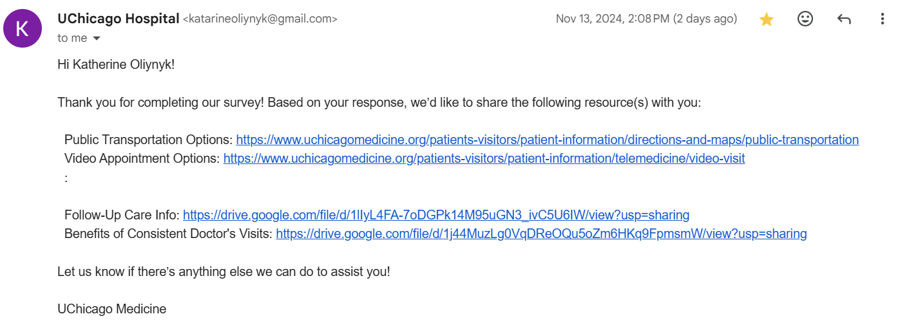
Automated Email Response
Notes:
Katherine

Slide 12
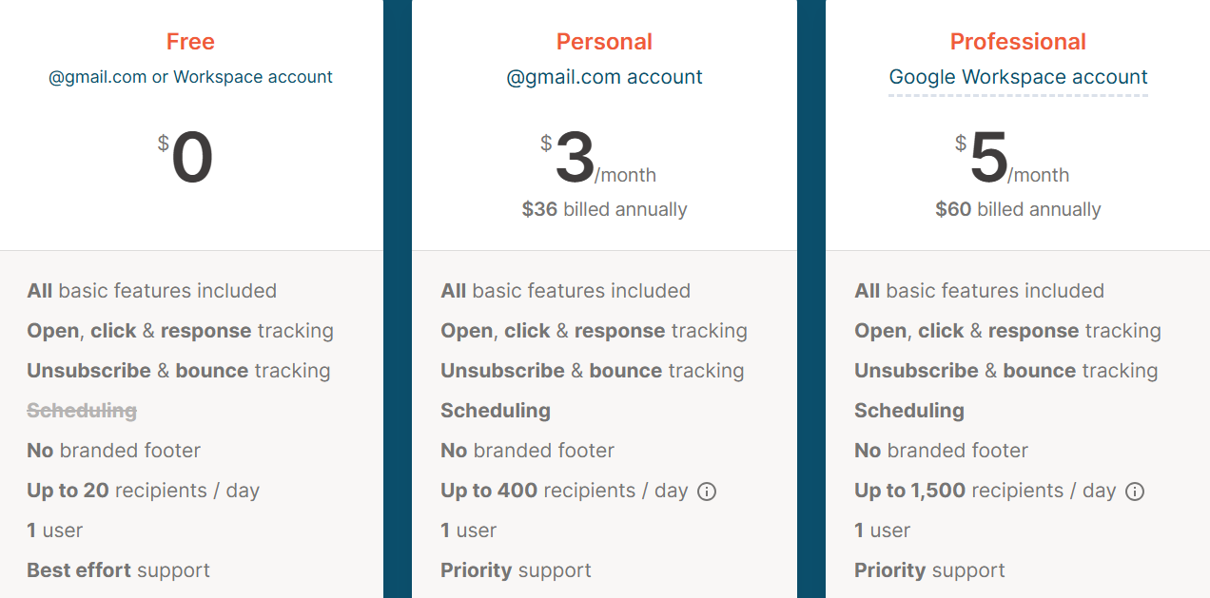
Yet Another Mail Merge
Notes:
Katherine

Slide 13
Use Case 3: Gather Patient Attendance History in EPIC
When an appointment is scheduled (by staff or patients), details are entered into EPIC scheduling system (EpicCare)
System generates a unique appointment ID and stores appointment in patient schedule
When the patient arrives for their appointment, they check in with the front desk, their identity is verified, and the visit is marked “arrived” / “checked-in”
Attendance status is assigned: “Completed”, “No Show”, “Canceled”. Status is updated by front desk staff
If patient reschedules, new appointment is generated in the system
Attendance history is stored as part of patient data
No-show data can be tracked by department, period of time, and patient
Current Process:
ID: 0003
Priority: High - Addressing No-Shows
Actor: Hospital Staff
Description: use case describes the current process of gathering patient attendance history using EPIC
Trigger: Staff needs to know patient attendance history
Type: Temporal
Preconditions: Patient data is present in EPIC
Notes:
Alexandra. Use case relates to attendance raffle. Patient history is used to determine raffle eligibility.

Slide 14








Attendance Incentive: Raffle
Use EPIC Patient Attendance history to enter patients into a raffle
Create monthly posters and graphics to promote the raffle
Notes:
Alexandra

Slide 15
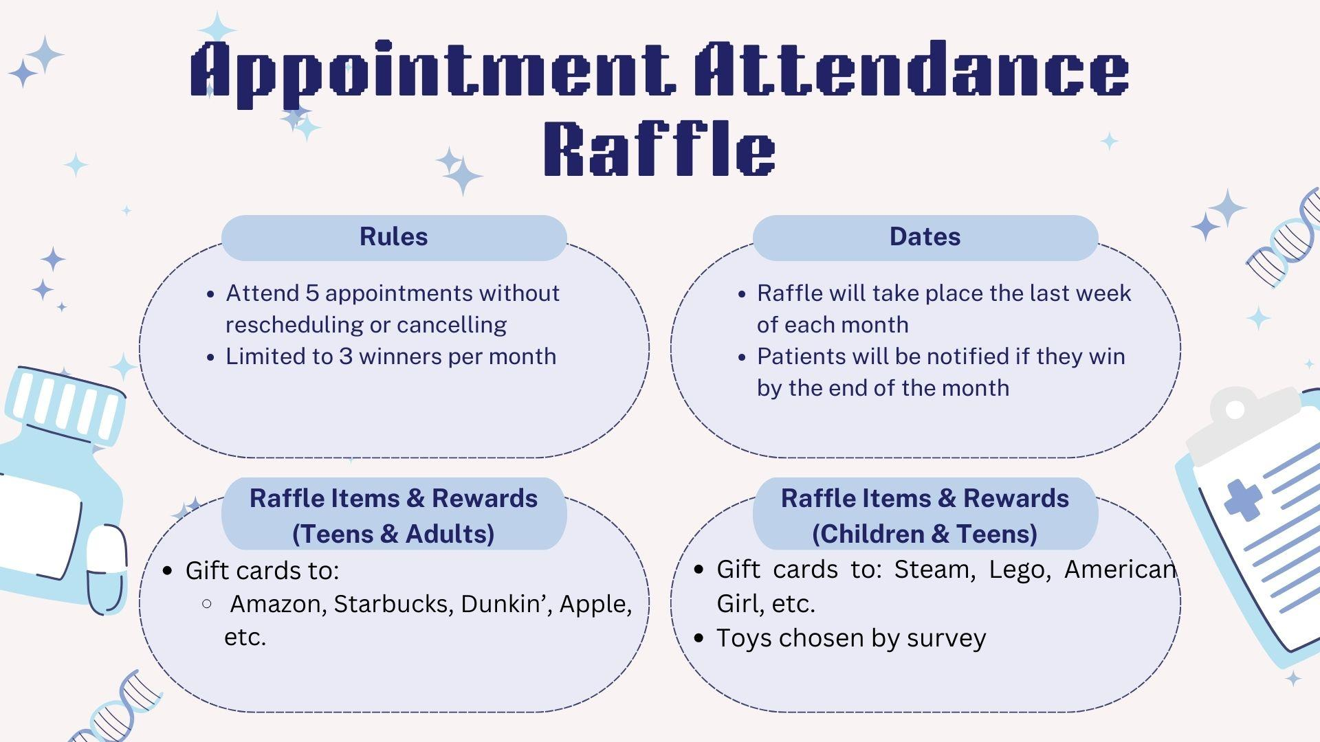
Notes:
Alexandra

Slide 16
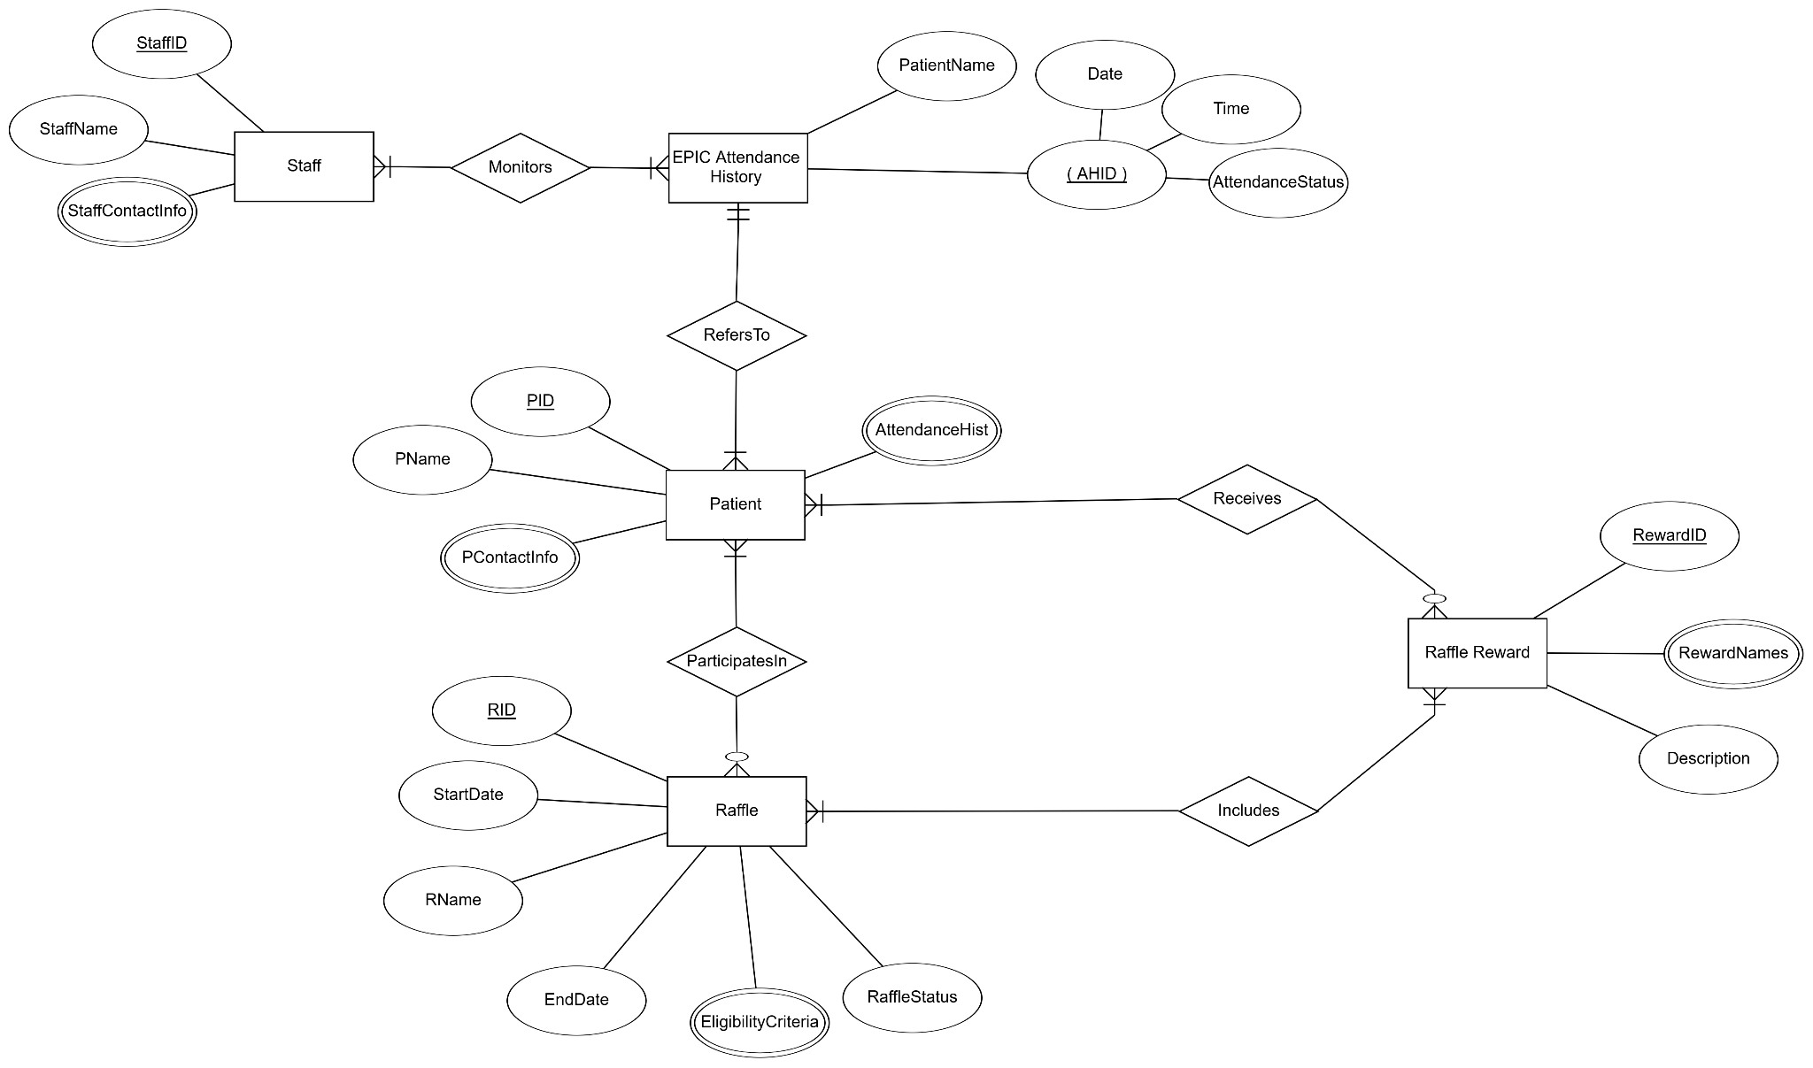
Raffle ERD
Notes:
Patryk

Slide 17
Raffle Costs
Lost Revenue From No-Shows
Physician Salary
Profit loss from inability to book other patients
Inefficient resource utilization
Low cost: only a set amount of winners.
Raffle prizes are affordable
Raffle may make patients more likely to attend appointments, decreasing revenue lost from no-shows
Notes:
Patryk

Slide 18
Functional Requirements
(Survey) Data Collection & Storage
01
Survey responses should be automatically entered into a linked google spreadsheet.
Survey responses should be timestamped.
Email Response Automation
02
Survey Responses should trigger customized email responses.
Email responses can be personalized based on survey responses.
Automate sending email via mail merge extension.
Analytics
03
Set appointment reminder frequency based on patient cancellation/no-show history from EPIC.
Use EPIC attendance history data to enter patients into raffle.
Require patients give their reason for cancellation in MyChart
Notes:
Patryk. Functional requirements are what the new system must do to provide the needed value to the business

Slide 19
Non-Functional Requirements
Operational
Web-based system run on any browser
Connect to printers wirelessly
Must integrate with existing hospital systems
01
Performance
Quick response time
New customer information is updated routinely
Scalability & ability to handle a large number of users
02
Accessibility
System should support multiple devices
Multilingual support for automated reminders
Available 24/7
03
Security
Follows HIPAA guidelines
Data encryption, backup & recovery
Manage and record which staff has access to patient information.
Maintain logs of user interactions, data modifications
04
Notes:
Bryce. Non functional requirements are the quality attributes, design, and implementation constraints which a system must have

Slide 20
Next Steps
How to Implement These Proposals:
Ownership of Google Form and Spreadsheet for survey will be transferred to hospital staff (or anyone assigned to the role)
Raffle Advertisement will be available to send to patients and display at hospital
Implement changes to current appointment reminder and cancellation systems
Notes:
Bryce

Slide 21

Thank You!

